Slide 1

Blockchain course BITCOIN PROTOCOL - A TECHNICAL OVERVIEW
Dr. Norbert Oláh

Slide 2

Table of Contents
Cryptographic Hash Functions
A Tamper-Evident Database
SIGS, ECDSA, AND ADDRESSES

Slide 3
CRYPTOGRAPHIC HASH FUNCTIONS
Notes:
The ideologies that went behind the technology.

Slide 4

INTEGRATION OF INFORMATION
CRYPTOGRAPHIC HASH FUNCTIONS
USED HIGHLY IN DIGITAL SIGNATURES
How do we ensure trust in communication in a trustless environment?
⇒ With cryptographic hash functions
Image source: https://spiritegg.com/wp-content/uploads/2016/03/63180952_fingerprint_types624.jpg
Notes:
A cryptographic hash function computes a value with constant length (usually small value) from a value with arbitrary finite length (usually a large one) in such a way that it’s very, very difficult to find a different large values that compute to the same small value. (collision resistance)

Slide 5
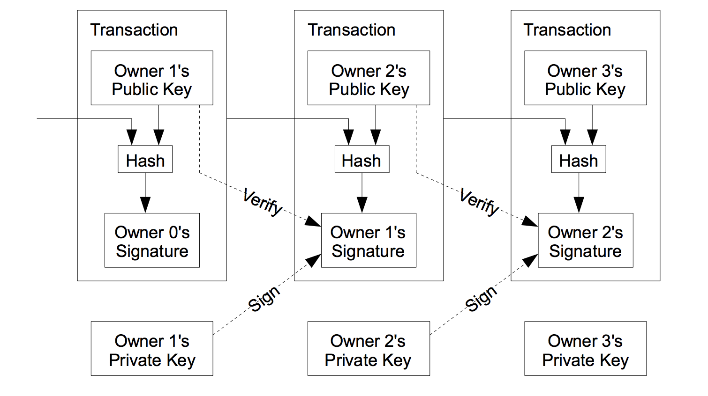
INTEGRATION OF INFORMATION
DIGITAL SIGNATURE
Generate Private and Public Key
Private Key to sign transaction and public key to verify transaction that was signed by a particular private key
Problem is that the payee cannot verify that one of the owners did not double spend.
Nothing new!
https://i.stack.imgur.com/YXguz.png

Slide 6
WHAT IS A HASH FUNCTION?
CRYPTOGRAPHIC HASH FUNCTIONS
x
f
f(x)
function
input
output

Slide 7
WHAT IS A HASH FUNCTION?
CRYPTOGRAPHIC HASH FUNCTIONS
x
H
H(x)
hash
function
Message
output
(Digest, tag, hash)

Slide 8
WHAT IS A HASH FUNCTION?
CRYPTOGRAPHIC HASH FUNCTIONS
any size
H
256 bits

Slide 9
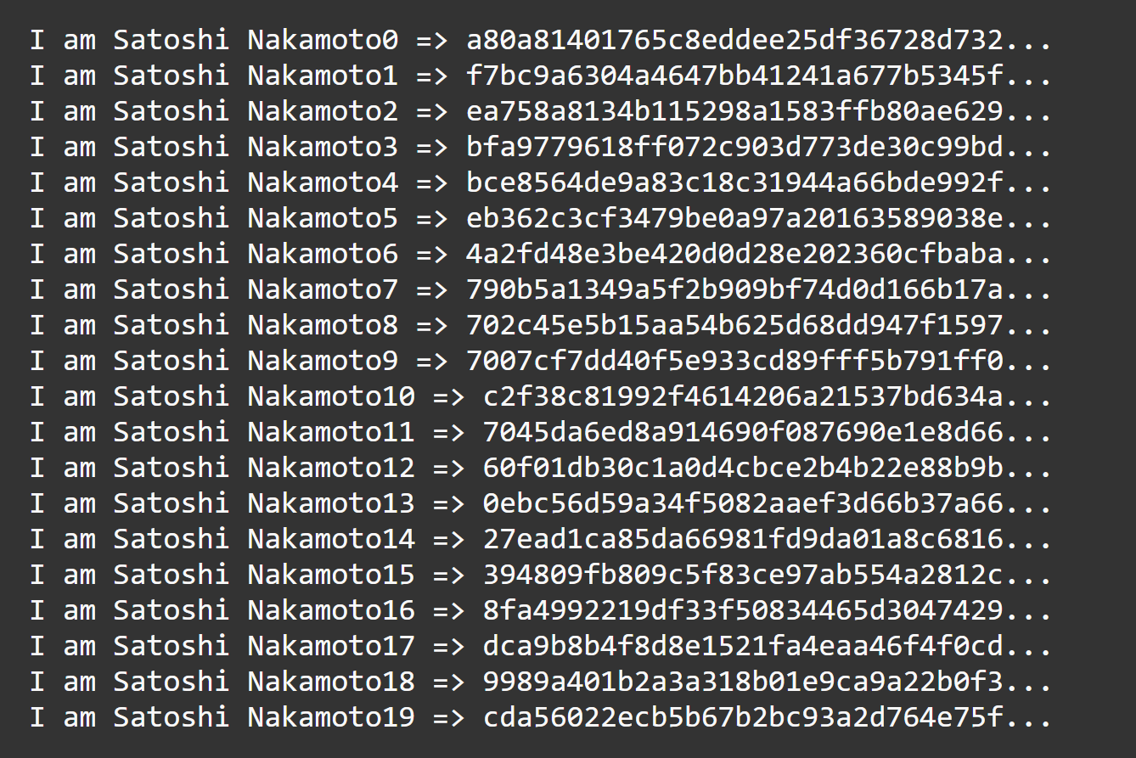
#CRYPTOGRAPHY
CRYPTOGRAPHIC HASH FUNCTIONS
Cryptographic hash function:
A hash function with three special properties:
Computationally Efficient
Collision resistance
Hide information
The equivalent of mathematical fingerprints/identifiers
Image source: http://chimera.labs.oreilly.com/books/1234000001802/ch08.html#_proof_of_work_algorithm

Slide 10
COMPUTATIONALLY EFFICIENT
CRYPTOGRAPHIC HASH FUNCTIONS
Computationally efficient:
Set of computation to get a digest/hash should not take a long time
Fingerprint analogy:
Whose fingerprint is this?

Slide 11
COLLISION RESISTANCE
CRYPTOGRAPHIC HASH FUNCTIONS
Collision Resistance:
It should be hard to find two inputs that maps the same output/hash/Digest.
Output should look random
Fingerprint analogy:
Can you find two random people with the same fingerprint?

Slide 12
HIDE INFORMATION
CRYPTOGRAPHIC HASH FUNCTIONS
Hide information:
Given the output, it should be hard to find anything interesting about the input. Ex: even or odd Number
Fingerprint analogy:
Can you find someone with the same fingerprint as you?

Slide 13
AVALANCHE EFFECT
CRYPTOGRAPHIC HASH FUNCTIONS
Avalanche effect: a small change in the input produces a pseudorandom change in the output
Often a significant difference from the first output
Prevents “hot or cold” game with inputs to produce or predict outputs

Slide 14
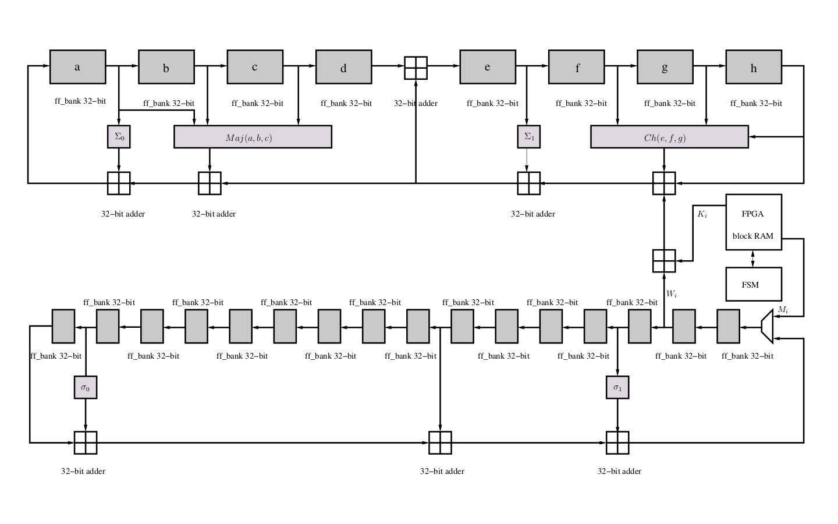
SHA-256^2
CRYPTOGRAPHIC HASH FUNCTIONS
SHA-256: A cryptographic hash function designed by the NSA
Bitcoin uses SHA-256^2 (“SHA-256 squared”), meaning that H(x) actually means SHA256(SHA256(x))
Image source: https://opencores.org/usercontent,img,1375985843

Slide 15
A TAMPER EVIDENT DATABASE
Notes:
The ideologies that went behind the technology.

Slide 16
DISSECTING THE BLOCKCHAIN
A TAMPER-EVIDENT DATABASE
BLOCK HEADER
PREV BLOCK HASH
NONCE
MERKLE ROOT
Notes:
Here’s what makes Bitcoin work at a technical level. Each of these different components of this block make up what’s called the block header. There are some small fields which I haven’t included because they aren’t essential to the protocol. These three parts alone implement everything that the high level overview discussed. The Prev Block Hash is the pointer to the previous block, the Merkle Root is a summary of transactions, and the nonce is the proof of work. We’ll discuss each one in depth shortly

Slide 17
BLOCK HEADER
A TAMPER-EVIDENT DATABASE
BLOCK HEADER
PREV BLOCK HASH
NONCE
MERKLE ROOT
blockID = H(blockHeader) = H(prevBlockHash || merkleRoot || nonce)
Notes:
Block header refers to all the components, block hash or block ID refers to the hash of the concatenated components

Slide 18
MERKLE ROOT
A TAMPER-EVIDENT DATABASE
BLOCK HEADER
PREV BLOCK HASH
NONCE
MERKLE ROOT

Slide 19
MERKLE ROOT
A TAMPER-EVIDENT DATABASE
MERKLE ROOT
= H(E || F)
E = H(A || B)
F = H(C || D)
A = H(TX₁)
B = H(TX₂)
C = H(TX₃)
D = H(TX₄)
TX₁
TX₂
TX₃
TX₄
Notes:
Merkle tree: Efficient commitment device
Merkle root: summary of transactions, changes with the contents of transactiosn

Slide 20
MERKLE ROOT
A TAMPER-EVIDENT DATABASE
MERKLE ROOT (TAMPERED)
= H(E || F’)
E = H(A || B)
F’ = H(C’ || D)
A = H(TX₁)
B = H(TX₂)
C’ = H(TX₃’)
D = H(TX₄)
TX₁
TX₂
TX₃’ (TAMPERED)
TX₄
Notes:
Merkle tree: Efficient commitment device
Merkle root: summary of transactions, changes with the contents of transactiosn

Slide 21
MERKLE BRANCH AND PROOF OF INCLUSION
A TAMPER-EVIDENT DATABASE
MERKLE ROOT
= H(E || F)
E = H(A || B)
F = H(C || D)
A = H(TX₁)
B = H(TX₂)
C = H(TX₃)
D = H(TX₄)
TX₁
TX₂
TX₃
TX₄
Notes:
Merkle tree: Efficient commitment device
Merkle root: summary of transactions, changes with the contents of transactiosn

Slide 22
PREVIOUS BLOCK HASH
A TAMPER-EVIDENT DATABASE
BLOCK HEADER
PREV BLOCK HASH
NONCE
MERKLE ROOT

Slide 23
PROTECTING THE CHAIN
A TAMPER-EVIDENT DATABASE
BLOCK HEADER
BLOCK HEADER
BLOCK HEADER
PREV BLOCK HASH
NONCE
PREV BLOCK HASH
NONCE
PREV BLOCK HASH
NONCE
MERKLE ROOT
MERKLE ROOT
MERKLE ROOT
SHA256(SHA256(x))
prevBlockHash = H(prevBlockHash || merkleRoot || nonce)

Slide 24
PROTECTING THE CHAIN
A TAMPER-EVIDENT DATABASE
BLOCK HEADER
BLOCK HEADER’
BLOCK HEADER’
PREV BLOCK HASH
NONCE
PREV BLOCK HASH
NONCE
PREV BLOCK HASH’
NONCE
MERKLE ROOT
MERKLE ROOT’ (TAMPERED)
MERKLE ROOT
SHA256(SHA256(x))
prevBlockHash = H(prevBlockHash || merkleRoot || nonce)
Notes:
REJECTION by the network due to difference

Slide 25
NONCE
A TAMPER-EVIDENT DATABASE
BLOCK HEADER
PREV BLOCK HASH
NONCE
MERKLE ROOT

Slide 26
HASH PUZZLE
A TAMPER-EVIDENT DATABASE
Bitcoin’s Proof of Work consensus requires miners to solve a computationally difficult puzzle
Hash puzzles need to be:
Computationally difficult.
Adjustable
Easily verifiable.
Notes:
Proof of work is a vehicle in which someone can show you that they’ve engaged in a significiant amount of computational effort.
Computationally difficult:
If finding the proof-of-work requires little work, what’s the point?
Parameterizable (variable) cost:
Allows for adjustments with global hash power changes (beállítható, hogy mennyi időbe teljen pl. 10 perc)
Easily verifiable
Should not need a central authority to verify nonce validity, should be inexpensive for other miners to confirm the validity of a hash

Slide 27
HASH PUZZLE
A TAMPER-EVIDENT DATABASE
Bitcoin’s partial preimage hash puzzle: A problem with a requirement to find a nonce that satisfies the following inequality:
H(prevBlockHash || merkleRoot || nonce) < target

Slide 28
HASH PUZZLE
A TAMPER-EVIDENT DATABASE
Bitcoin’s partial preimage hash puzzle:
H(prevBlockHash || merkleRoot || nonce) <
0x0000ffffffffffffffffffffffffffffffffffffffffffffffffffffffffffff

Slide 29
HASH PUZZLE
A TAMPER-EVIDENT DATABASE
0x1312af178c253f84028d480a6adc1e25e81caa44c749ec81976192e2ec934c64
<
0x0000ffffffffffffffffffffffffffffffffffffffffffffffffffffffffffff
H(prevBlockHash || merkleRoot || nonce)
H(“Hello, world!0”)

Slide 30
HASH PUZZLE
A TAMPER-EVIDENT DATABASE
H(prevBlockHash || merkleRoot || nonce)
0xe9afc424b79e4f6ab42d99c81156d3a17228d6e1eef4139be78e948a9332a7d8
<
0x0000ffffffffffffffffffffffffffffffffffffffffffffffffffffffffffff
H(“Hello, world!1”)

Slide 31
HASH PUZZLE
A TAMPER-EVIDENT DATABASE
H(prevBlockHash || merkleRoot || nonce)
0x0000c3af42fc31103f1fdc0151fa747ff87349a4714df7cc52ea464e12dcd4e9
<
0x0000ffffffffffffffffffffffffffffffffffffffffffffffffffffffffffff
Solved!
H(“Hello, world!4250”)

Slide 32

MINING
A TAMPER-EVIDENT DATABASE
Invalid Block
Mining is like throwing darts at a target while blindfolded:
Equal likelihood of hitting any part of the target
Faster throwers ⇒ more hits / second
Miners look for a hash below an algorithmically decided target
Valid Block
H(prevBlockHash || merkleRoot || nonce) < target
Notes:
Mining is the process of solving this partial preimage hash puzzle.
Mining, for those of you who love analogies like myself, is like throwing darts at a target while blindfolded:
Equal likelihood of hitting any ring
Faster throwers ⇒ more hits / second
Difficulty inversely proportional to green ring size
Green ring adjusts depending on average time to produce valid result
If people get better at throwing darts, green circle needs to get smaller

Slide 33
BLOCK DIFFICULTY
A TAMPER-EVIDENT DATABASE
Invalid Block
Invalid Block
Difficulty: A representation of the expected number of computations required to find a block
Implemented as requirement of leading number of 0s
Adjusts with global hashrate
Adjusts every 2016 blocks (~2 weeks)
Valid Block
H(prevBlockHash || merkleRoot || nonce) < target
Notes:
Difficulty: A way to adjust the problem

Slide 34
ADJUSTING DIFFICULTY
A TAMPER-EVIDENT DATABASE
H(prevBlockHash || merkleRoot || nonce) <
0x0000ffffffffffffffffffffffffffffffffffffffffffffffffffffffffffff
0x000000000000ffffffffffffffffffffffffffffffffffffffffffffffffffff
0x00000000ffffffffffffffffffffffffffffffffffffffffffffffffffffffff

Slide 35
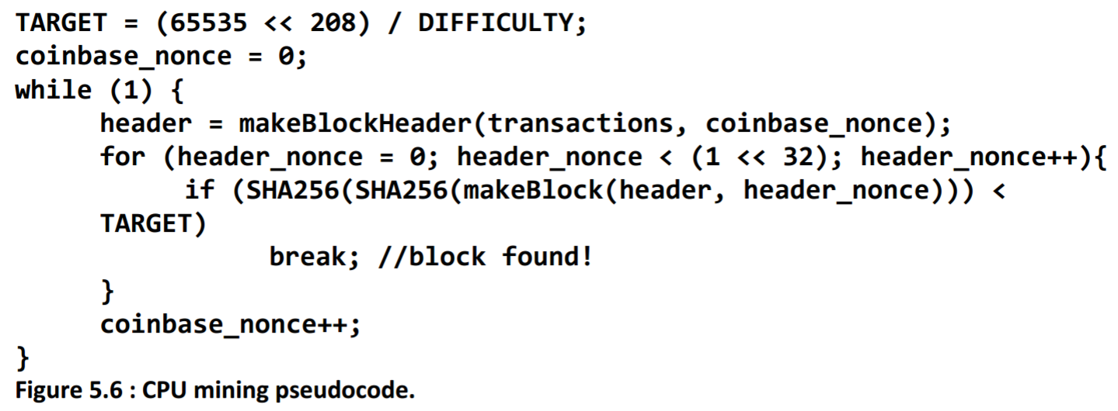
MINING PSEUDOCODE
A TAMPER-EVIDENT DATABASE
Source: (from Princeton Textbook, 5.2)
Notes:
“partial preimage hash puzzle”

Slide 36
BLOCK DIFFICULTY
A TAMPER-EVIDENT DATABASE
If the current difficulty is D then the target hash is: 0x00000000FFFF0000000000000000000000000000000000000000000000000000 / D
The number of valid hashes is: 65535 * 2²⁰⁸ / D
This means that the ratio of all hashes over valid hashes would be: 2²⁵⁶ / (65535 * 2²⁰⁸ / D) = D * 2⁴⁸ / 65535 = D * 4295032833
Notes:
Difficulty: A way to adjust the problem

Slide 37
BLOCK DIFFICULTY
A TAMPER-EVIDENT DATABASE
Which, at the current (January 2017) difficulty of D = 392963262344.3704 means that one hash in 392963262344.3704 * 4295032833 = 1687790113931869416948
results in a valid block, or each attempt has a chance of 1 / 1687790113931869416948 = 0.000000000000000000059 %
Notes:
Difficulty: A way to adjust the problem

Slide 38
EXAMPLE BLOCK
A TAMPER-EVIDENT DATABASE
REAL BITCOIN BLOCK EXAMPLE
https://www.blockchain.com/explorer
Source: https://blockchain.info/block/00000000000000000013942c4215cd92306bbce769cfcb349d0b42f031c994eb
Notes:
“partial preimage hash puzzle”

Slide 39
SIGNS, ECDSA, AND ADDRESSES
Notes:
The ideologies that went behind the technology.
We’re going to examine how individual transactions between users are secured. We’ll be discussing generation of private keys, public keys, signatures, addresses, and more.

Slide 40
BEING IDENTIFIABLE WITHOUT IDENTITY
INTRO TO DIGITAL SIGNATURE ALGORITHMS
Dilemma:
When sending transactions to other users, we want 2 seemingly contradictory things to happen:
Tie user identity to a transaction
Have no sensitive identifiable characteristics associated with a particular transaction
Notes:
Alright, so when it comes to securing transactions, we seem to have a dilemma. We want to be able to tie a specific identity to a transaction to confirm that a certain user sent it, but at the same time we want to make it so that just by looking at the transaction, anyone looking at it can’t just recover sensitive identifiable information about the user. Because if this was possible, then other people can break into my UTXOs and spend my bitcoin!

Slide 41
PUBLIC KEY CRYPTOGRAPHY
INTRO TO DIGITAL SIGNATURE ALGORITHMS
Public Key Cryptography: Public-key cryptography, or asymmetric cryptography, is the field of cryptographic systems that use pairs of related keys.
Each key pair consists of a public key and a corresponding private key.
Key pairs are generated with cryptographic algorithms based on mathematical problems termed one-way functions.
Security of public-key cryptography depends on keeping the private key secret; the public key can be openly distributed without compromising security
Notes:
In order to achieve these two properties, Bitcoin uses public key cryptography.

Slide 42
PUBLIC KEY CRYPTOGRAPHY
INTRO TO DIGITAL SIGNATURE ALGORITHMS
Public Key: information about a user that can be distributed widely
Private Key: sensitive information about a user that should be only known by the user
Notes:
These two pieces of information form the cornerstone of public key cryptography. We’ll explore how these pieces of information are used to achieve what we want + how they are generated later.
The public key allows an individual to receive funds, while the private key will allow users to access and send funds.

Slide 43
PUBLIC KEY CRYPTOGRAPHY
ECDSA (ELLIPTIC CURVE DSA)
Elliptic Curve Digital Signature Algorithm (ECDSA):
the algorithm the Bitcoin network uses to generate public keys and verify transactions.
a variant of standard DSA but with elliptic curves
Notes:
Now, we’ll get into a walkthrough of how transaction verification works.

Slide 44
SIGNATURE GENERATION AND VERIFICATION
ECDSA IN ACTION
ALICE
BOB
Private Key
Alice uses a random number generator to create a private key
Disclaimer: this is not the complete story of what happens when making a transaction on the Bitcoin network. This is a general representation of transaction verification using ECDSA.
Notes:
Alright, so say that we have two individuals in the network, Alice and Bob.

Slide 45
SIGNATURE GENERATION AND VERIFICATION
ECDSA IN ACTION
ALICE
BOB
Private Key
Public Key
Alice uses ECDSA to calculate public key
Disclaimer: this is not the complete story of what happens when making a transaction on the Bitcoin network. This is a general representation of transaction verification using ECDSA.
Notes:
We’ll use digital signature schemes to gain a general understanding of what tools we use and how we use them to authenticate identity on the Bitcoin network. This isn’t necessarily the exact same thing that Bitcoin does, but hey, this is a pretty useful analogy in helping understand how transactions are facilitated on a technical level in the Bitcoin network.
We’ll start with an example. We will be walking through the example from the perspective of Alice, so we know what Alice’s private key is.
The goal: Somehow, we want to develop a means to authenticate identity so you know a message could only have come from one person. However, it’s also crucial that parties retain their anonymity.

Slide 46
SIGNATURE GENERATION AND VERIFICATION
ECDSA IN ACTION
ALICE
BOB
Alice’s public key is knowledge that can be shared. Bob will receive Alice’s public key.
Private Key
Alice's Public Key
Public Key
Notes:
In order for Bob to make sure that a message has come from Alice, he needs Alice’s public key. Recall that a public key is publically available: it’s like an email address

Slide 47
SIGNATURE GENERATION AND VERIFICATION
ECDSA IN ACTION
ALICE
BOB
Private Key
Alice has some transaction to send to Bob.
Public Key
Alice's Public Key
Transaction
Notes:
In order for Bob to make sure that a message has come from Alice, he needs Alice’s public key. Recall that a public key is publically available: it’s like an email address

Slide 48
SIGNATURE GENERATION AND VERIFICATION
ECDSA IN ACTION
ALICE
BOB
Private Key
Alice hashes her transaction.
Alice's Public Key
Public Key
Transaction
Transaction Hash

Slide 49
SIGNATURE GENERATION AND VERIFICATION
ECDSA IN ACTION
ALICE
BOB
Private Key
Public Key
Alice's Public Key
Transaction
Transaction Hash
Signature
Alice produces a signature using the hash, private key, and elliptic curve.

Slide 50
SIGNATURE GENERATION AND VERIFICATION
ECDSA IN ACTION
ALICE
BOB
Private Key
Alice's Public Key
Alice sends the original transaction and signature to Bob.
Public Key
Transaction
Alice's Transaction
Signature
Alice's Signature

Slide 51
SIGNATURE GENERATION AND VERIFICATION
ECDSA IN ACTION
ALICE
BOB
Private Key
Alice's Public Key
Alice sends the original transaction and signature to Bob.
Public Key
Transaction
Alice's Transaction
Signature
Alice's Signature

Slide 52
SIGNATURE GENERATION AND VERIFICATION
ECDSA IN ACTION
ALICE
BOB
Private Key
Alice's Public Key
Bob will be able to verify if Alice created the signature.
Public Key
Alice's Transaction
Transaction
Alice's Signature
Signature
or
Notes:
With the information that Bob has on hand, he will be able to use the signature verification algorithm to verify that Alice created the signature. The signature verification algorithm involves some quick maths.

Slide 53
SIGNATURE GENERATION AND VERIFICATION
ECDSA IN ACTION
ALICE
BOB
Private Key
Alice's Public Key
However, Bob cannot easily recover Alice’s private key.
Public Key
Alice's Transaction
Transaction
Alice's Signature
Signature
or
Notes:
It’s really hard to reverse engineer the private key from the information Bob has available to him due to the nature of the math that went into calculating the public key and signature.
Thus, we’ve achieved our two goals: Alice was able to confirm that yes, she made the transaction, but without ever having to show Bob her private key once!

Slide 54
SIGNATURE GENERATION AND VERIFICATION
ECDSA IN ACTION
EVE
ALICE
BOB
Eve’s Private Key
Private Key
Eve’s Public Key
Alice's Public Key
Public Key
Transaction
Signature
Notes:
Okay, let’s say that now there’s a third party, named Eve, that wants to tamper with Alice’s transaction. We’ll denote Eve’s private key as neon green, and Eve’s public key as cyan.

Slide 55
SIGNATURE GENERATION AND VERIFICATION
ECDSA IN ACTION
EVE
ALICE
BOB
Private Key
Eve’s Private Key
Alice's Public Key
Public Key
Eve’s Public Key
Transaction
private key + message = signature
Signature
Notes:
Okay, let’s say that somehow, Eve was able to get her hands on the original transaction that Alice made. Even if she tried to pass of the transaction as her own, Bob would be able to verify that Eve did not make the original transaction.

Slide 56
SIGNATURE GENERATION AND VERIFICATION
ECDSA IN ACTION
EVE
ALICE
BOB
Private Key
Eve’s Private Key
Alice's Public Key
Public Key
Eve’s Public Key
Transaction
Alice's Transaction
Alice's Transaction
Signature
Eve’s Signature
Eve's Signature
Notes:
Okay, let’s say that somehow, Eve was able to get her hands on the original transaction that Alice made. Even if she tried to pass of the transaction as her own, Bob would be able to verify that Eve did not make the original transaction.

Slide 57
SIGNATURE GENERATION AND VERIFICATION
ECDSA IN ACTION
EVE
ALICE
BOB
Private Key
Eve’s Private Key
Alice's Public Key
Public Key
Eve’s Public Key
Transaction
Alice's Transaction
Alice's Transaction
Signature
Eve’s Signature
Eve's Signature
Notes:
By running through the signature verification algorithm with Alice’s public key with Eve’s signature, Bob will be able to tell that no, it was not Alice that produced this signature. Even though the transaction and transaction hash remains the same, the signature is fundamentally different since it was produced using Eve’s private key. Thus, users cannot pass off a transaction as their own if they were not the original intended sender of the transaction.

Slide 58
GUARANTEED PROPERTIES
ECDSA SUMMARY
Recipients given the (message, signature) pair should be able to verify:
Message Origin: original sender (owner of private key) has authorized this message/transaction
Non-repudiation: original sender (owner of private key) cannot backtrack
Message Integrity: transaction cannot have been modified since sending
Notes:
signature proves that owner of the private key (aka also the funds) has AUTHORIZED SPENDING of the funds and the signature also indicates that the recipient of the funds can also spend these funds.
proof of authorization is UNDENIABLE, non-repudiation. The sender of a transaction simply cannot go and “oh, I didn’t send you that transaction? What are you talking about?” because Bob will be able to verify the produced signature as belonging to that user.
message integrity: signature proves that transaction CANNOT BE MODIFIED by anyone after signing. If the transaction becomes tampered with somehow after the it and the signature has been sent, Bob will know as the tampered message will not produce the exact same hash.

Slide 59
LAYERS AND LAYERS UPON MYSTERY
CONVERSION SUMMARY
Random Number Generator
Private Key
Public Key
Public Key Hash
Bitcoin Address
ECDSA
Hash Functions
Bech32
SHA-256
RIPEMD160
Notes:
Alright, so here we have here is a flowchart representing how Bitcoin generates the information used in sending and receiving transactions. What we didn’t mention earlier is that despite in the earlier analogy we said that transactions are sent to public keys, they are actually sent to Bitcoin Addresses. Now we’ll take a more granular look at how Bitcoin goes about generating these necessary pieces of information.

Slide 60
LAYERS AND LAYERS UPON MYSTERY
CONVERSION SUMMARY
Random Number Generator
Private Key
Public Key
Public Key Hash
Bitcoin Address
ECDSA
Hash Functions
Bech32
SHA-256
RIPEMD160
Notes:
Alright, so here we have here is a flowchart representing how Bitcoin generates Now we’ll take a more granular look at how Bitcoin goes about generating these necessary pieces of information.

Slide 61
RANDOM NUMBER GENERATORS ARE NOT CREATED THE SAME
PRIVATE KEY GENERATION
Private Keys on Bitcoin: 256-bit unsigned integers
Private keys on Bitcoin are not generated using regular random number generators.
Chances of two different individuals generating the same private key (collision) is extremely low.
~2²⁵⁶ unique private keys
Chances of collision: (1/2²⁵⁶) * (1/2²⁵⁶) = really, really low
Notes:
Private keys on Bitcoin are generally at their very core, 256-bit unsigned integers. Now they often are represented in different bases or formats but at the end of the day they’re just 256-bit unsigned integers.
We’ll find that private keys on Bitcoin are not generated using regular random number generators, as these are often not truly random, and thus not cryptographically secure. There are different ways one can go about generating valid private keys for the Bitcoin network, some methods are more secure/convenient than others. We’ll often find that in real life, private key generation is handled by wallet softwares.
There are approximately 2^256 valid private keys for the Bitcoin network. Actual number is a little lower than that as not all 256-bit unsigned integers are valid ECDSA inputs.

Slide 62
LAYERS AND LAYERS UPON MYSTERY
CONVERSION SUMMARY
Random Number Generator
Private Key
Public Key
Public Key Hash
Bitcoin Address
ECDSA
Hash Functions
Bech32
SHA-256
RIPEMD160
Notes:
Alright, so here we have here is a flowchart representing how Bitcoin generates Now we’ll take a more granular look at how Bitcoin goes about generating these necessary pieces of information.

Slide 63
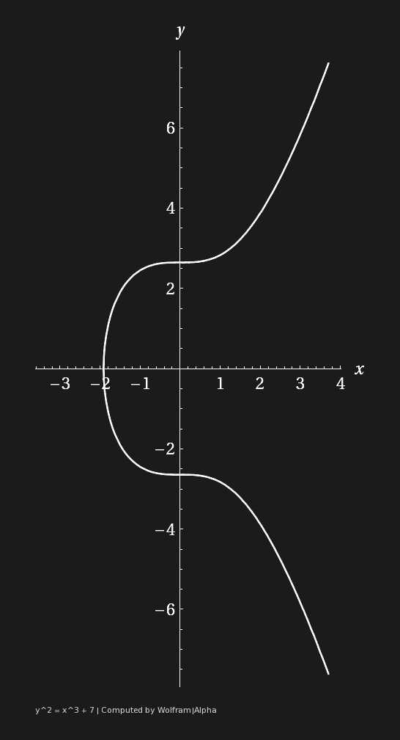
ELLIPTIC CURVES (SECP256K1)
PUBLIC KEY GENERATION
Bitcoin uses ECDSA (Elliptic Curve Digital Signature Algorithm) to produce public keys
The Elliptic Curve is defined by some mathematical function
Bitcoin’s Elliptic Curve:
secp256k1 : Y² = ( X³ + 7 ) over ( F_{p} )
Notes:
bitcoin uses ECDSA, which stands for Elliptic Curve Digital Signature Algorithm to find its private and public key pairs
the mathematical definition for Elliptic curve cryptography: it defines a finite abelian group that you can pose the discrete logarithm problem on
in English: defines a mathematical function using a curve like this, in order to create a trapdoor function
secp256k1 was constructed in a special non-random way which allows for especially efficient computation (30% faster than others)
for those of you who want to know the math, it’s y2 = x3 + 7 over finite field of prime order p
“To visualize how much harder it is to break, Lenstra recently introduced the concept of "Global Security." You can compute how much energy is needed to break a cryptographic algorithm, and compare that with how much water that energy could boil. This is a kind of cryptographic carbon footprint. By this measure, breaking a 228-bit RSA key requires less energy to than it takes to boil a teaspoon of water. Comparatively, breaking a 228-bit elliptic curve key requires enough energy to boil all the water on earth. For this level of security with RSA, you'd need a key with 2,380-bits.” (from https://blog.cloudflare.com/a-relatively-easy-to-understand-primer-on-elliptic-curve-cryptography/)

Slide 64
ELLIPTIC CURVE SCALAR MULTIPLICATION
PUBLIC KEY GENERATION
Using a private key as an input, we can generate a public key by performing point multiplication/elliptic curve scalar multiplication.
Key thing to note here: point multiplication is a trapdoor function.
This means calculating the public key is a one-way function.
Notes:
For the purposes of this lecture, point multiplication will simply be defined as the process of repeatedly adding a point on an elliptic curve to itself repeatedly. Point multiplication is a trapdoor function, or a one way function.This just means that it is extremely difficult to reverse engineer the private key from the public key.

Slide 65
TIME COMPLEXITY
PUBLIC KEY GENERATION
Input: public key
Output: corresponding private key
256 bit private key, takes O(sqrt(n)) operations to crack
15 * pow(2,40) hashes per second on the ENTIRE Bitcoin network
pow(2,128) / (15 * pow(2,40)) / 3600 / 24 / 365.25
= 0.6537992112229596e18
650 million billion years
Notes:
If you’re having trouble following the slide, that’s alright. The main takeaway here is that the ECC is a trapdoor function, which means it’s computationally infeasible to calculate the private key from the hashed result.

Slide 66
LAYERS AND LAYERS UPON MYSTERY
CONVERSION SUMMARY
Random Number Generator
Private Key
Public Key
Public Key Hash
Bitcoin Address
ECDSA
Hash Functions
Bech32
SHA-256
RIPEMD160
Notes:
Alright, so here we have here is a flowchart representing how Bitcoin generates Now we’ll take a more granular look at how Bitcoin goes about generating these necessary pieces of information.

Slide 67
PUBKEY TO PUBKEY HASH
PUBLIC KEY TO BITCOIN ADDRESS
PUBLIC KEY
{
}
PUBKEYHASH = RIPEMD160(SHA256(K))
SHA-256 (Secure Hashing Algorithm)
Used extensively in bitcoin scripts and mining
RIPEMD (RACE Integrity Primitives Evaluation Message Digest)
Produces 160-bit (20-byte) number
SHA256
“Double Hash” or HASH160
RIPEMD160
PUBLIC KEY HASH
BECH32
BITCOIN ADDRESS
Notes:
start with the motivation:
protect the public keys from exposure
if quantum comptuers exist, we can use them to break the public key, but they can’t break the public key hash
All information is just digital data, 0s and 1s, and that data can be manipulated at any time. For example, if I send Brian some information through Nadir, what’s to stop him from screwing up the data before he passes it along? We need something to detect when information is tampered, whether information that’s being received from the past or information that’s being transmitted in the present. TAMPER EVIDENT
With cryptographic hash functions, we give each piece of information a fingerprint based on the information it represents. Each human being fortunately (or unfortunately for bank robbers) has a 10 fingerprints unique to them which can be used to identify you. Banks, the DMV, your phone, all of the following identify you based solely on your fingerprint. It’s something that only you have. At least, according to probability. Similarly, functions have been designed to give a piece of information a unique identifier, so that we can quickly tell whether a message has changed.
ripemd -> makes it smaller -> less memory expensive

Slide 68
LAYERS AND LAYERS UPON MYSTERY
CONVERSION SUMMARY
Random Number Generator
Private Key
Public Key
Public Key Hash
Bitcoin Address
ECDSA
Hash Functions
Bech32
SHA-256
RIPEMD160
Notes:
Now transactions are actually sent to Bitcoin addresses. I’m not going to go too indepth about bech32, but some fun things to note:
Bech32 is a relatively new address format for users, it’s not the original address format. This address format was implemented as part of implementing segwit as an upgrade to the Bitcoin protocols.
Bech32 is more efficient for blocks compared to previous address formats.

Slide 69
Questions?

Slide 70
Thank you for your attention!

